Slide 1
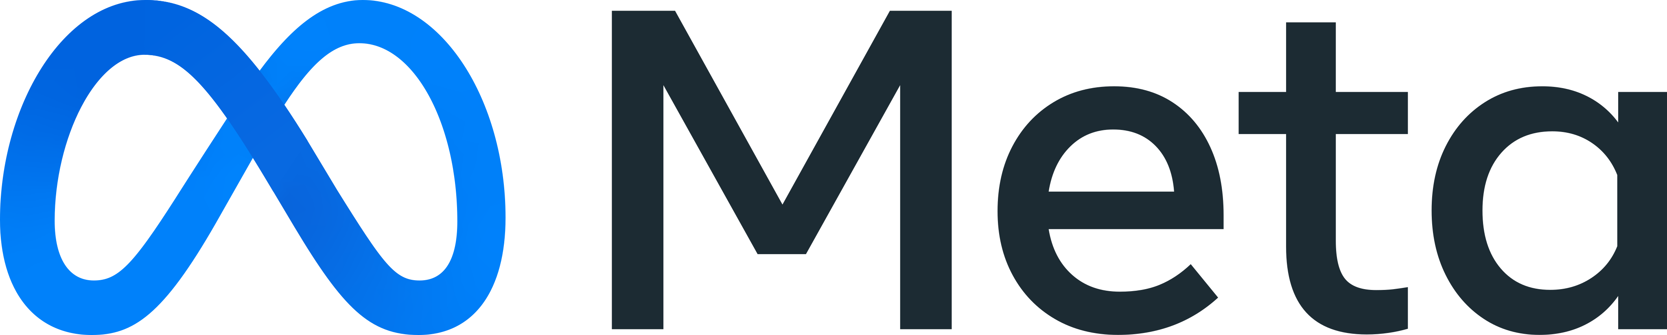
Agenda
Everything you need to know about Facebook Ads Manager in 2022
--------------------------------------------------------------------------------------------------------
A simple guide for a successful path
“Stopping advertising to save money is like stopping your watch to save time”
-Henry Ford

Slide 2

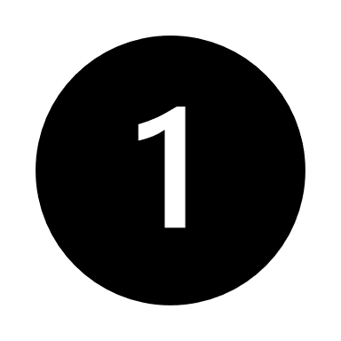
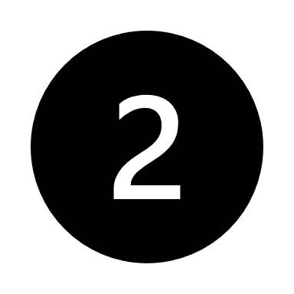
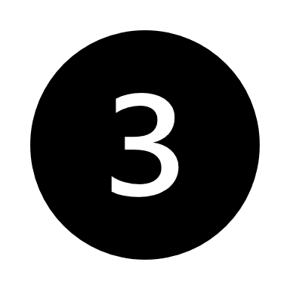
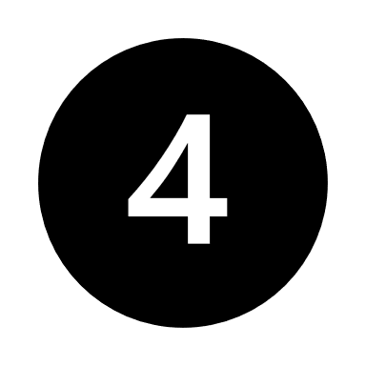
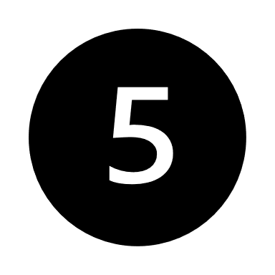
..Why Facebook Ads?
Agenda
One of the most popular marketing platforms on the planet with more than 2.7 billion active users.
Businesses can create ads to narrow down their target audiences for segments under gender, age, location, languages, education level, job title, interests, behaviors and recent purchases
Advertising can be affordable and low cost (you set your own budget)
You can have results very fast (once an ad goes live, it starts working immediately and begin showing it to potentially thousands of people instantly)
Access to powerful, in-depth data

Slide 3
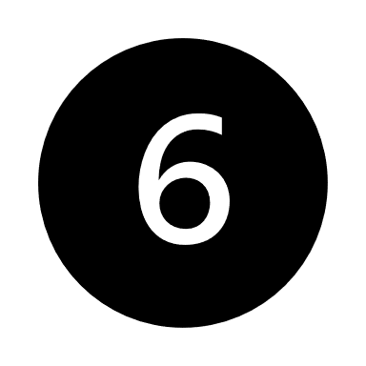
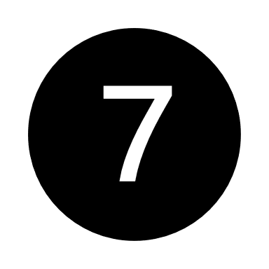
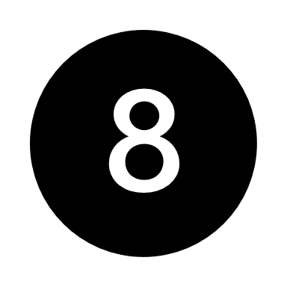
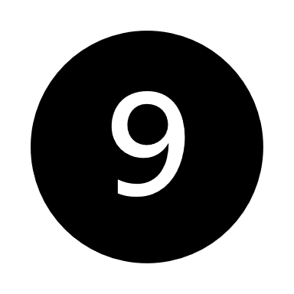
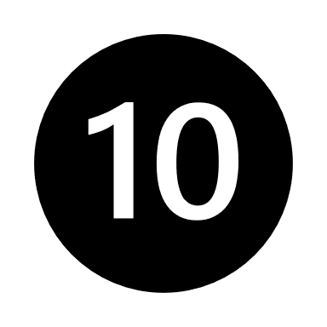
..Why Facebook Ads?
Agenda
Filter ads to block audiences you don’t want
Full-Funnel targeting with multiple form of engagement
Variety of ad formats
You can reach far more people than you ever will with organic posts
You can encourage customer loyalty

Slide 4
Let’s start!

Slide 5

Agenda
01
02
03
04
05
06
07
08
09
10
11
Campaign Objectives
Budget and scheduling
Audience Targeting
Placements
Optimization and Delivery
Creatives
Performance metrics
Basic – key concepts
Events Manager, Business Manager & Commerce Manager
Test & answers
Useful links

Slide 6
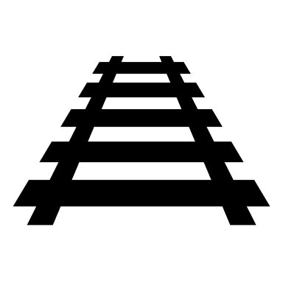
Chapter 01
Chapter 01
Agenda
Campaign Objectives
What are the campaign objectives?
What is ODAX?
Facebook’s campaign objectives are 11 categorized in 3 major levels: Awareness, Consideration, Conversion. Let’s take a closer look!
Awareness Objective
Reach
As the campaign objective indicates, reach campaigns optimize your ads for delivery to maximum people. Facebook will show your ads to as many people as possible in your target audience within your budget constraints. You might choose this objective if your goal is to get as many eyes on your ads as possible without expecting people to take immediate action after seeing them. Keep in mind that reach campaigns fall under the funnel of brand awareness. That means that their main goal is to make your business known. It's very important to implement a reach campaign when an account is new, but don’t rely on them to get you conversions. In general, reach campaigns work better than brand awareness campaigns because they have a more measurable outcome.
2. Brand Awareness
The awareness objective is for campaigns where you want to show ads to people who are most likely to remember them. Ads Manager will show you “estimated ad recall lift” data, which is the number of people Facebook estimates would remember your ad if they were asked within 2 days of seeing it. It is noted that the estimated recall lift is never 100% accurate because of shortage of time or neglection. And that’s why reach campaigns are considered more accurate and better for brand awareness.
B. Consideration Objective
3. Traffic
The main objective of traffic campaigns is to drive traffic to your website.
These campaigns will target people that are frequent clickers. The main 2 optimizations for traffic campaigns are (1) link clicks and (2) landing page
01

Slide 7
Chapter 01
Chapter 01
Agenda
Campaign Objectives
views. At the ad level of your campaign, you can choose the destination URL, which can be any target website you choose. In general, traffic campaigns are relatively cheap compared to conversions, as they belong in the consideration or middle part of the funnel. But there are ways to target high niche and more converting audiences. One way of doing this is by optimizing for landing page views because you can target more engaging audiences. Another way is targeting with the detailed targeting option. For example, if you use the detailed targeting behavior ‘’online shopping’’ and narrow down your audience for engaged shoppers (engaged shoppers are the people that have clicked on the buy now button the most for the last 7 days) then you will have targeted a high converting audience with a traffic campaign. Keep in mind that this could impact metrics such as CPR and reach. But again, this shows that you don’t necessarily need conversion campaigns to target buyers.
4. Engagement
If the primary goal of your Facebook ads is to get engagement, go with the Engagement objective. Facebook will show your ads to the people in your target audience who are most likely to engage with them.
When setting up an ad with this objective, you can choose from three engagement type options:
Post Engagement: Engagement from this type of ad includes reactions, comments, shares, video views, and all clicks, and it helps build social proof on a post or ad.
Page Likes: If your primary objective is to grow your Facebook page followers, choose the Page Likes engagement type to reach people who will click to “like” your page. This option is available only on Facebook and can’t be used to grow your Instagram followers.
Event Responses: If you have a Facebook event, you can use this engagement type to get more people to respond to it.
The Engagement campaign objective is ideal if you want to increase your page fans, add social proof to a post, or increase sign-ups to a Facebook event.
02

Slide 8
Chapter 01
Chapter 01
Agenda
Campaign Objectives
5. App Installs
If you have an app and your primary goal is to increase downloads, the App Installs campaign objective is a great choice. Your ads will then be shown to the people in your audience who are most likely to install an app. Clicking the ad will take them directly to their app store to download your app.
6. Video views
If you choose the Video Views objective, Facebook will prioritize showing your video ad to people in your target audience who are most likely to watch the video.
7. Lead Generation
The Lead Generation objective allows you to add a contact form to your Facebook ad. You can also customize the form to ask other qualifying questions if you need to collect more information.
8. Messages
f your primary objective is to start conversations with people in Messenger or Instagram Direct, the Messages campaign objective can be very effective. Facebook will show your ads to the people most likely to send you a message based on their history.
C. Conversion objective
9. Conversions
As we get further down in the funnel, that's where we reach conversion campaigns. Conversion campaigns can be your greatest ally when you want sales. A conversion is an action in your website. That could be a view content, an ad to cart, initiate checkout or a purchase. These are the main events of a conversion campaign. Considering that conversion campaigns are situated in the bottom of the funnel, it’s obvious to assume that they are the ones with the
highest cost.
03

Slide 9
Chapter 01
Chapter 01
Agenda
Campaign Objectives
Every decision you take when you create or optimize a conversions campaign is more serious because a possible mistake is more expensive as well. Conversion acquisitions bring higher CPR’s than remarketing’s, as prospecting campaigns (see about prospecting audiences in Chapter 3) are trying to reach new audiences. The key to a successful conversions campaign is to have the right budget for the region you are targeting and the right audience. A smart technique and one that most successful advertisers are using nowadays, is experimenting with a higher funnel event first (like view content), check that there is demand and good CPRs, and then build a conversion optimized for purchases in the same way. Something important to have in mind is that you can’t run a conversions campaign without having the Facebook pixel and conversions API first (check Chapter 09).
10. Catalog Sales
If you’re a product-based business, you can create a catalog on Facebook and use the Catalog Sales objective to show products to your target audience. These are known as dynamic product ads and let you show users a variety of products in your ads or retarget with specific products based on someone’s activity on your website.
11. Store Traffic
The Store Traffic objective is perfect if you have more than one store and want people to visit their nearest location.
04

Slide 10
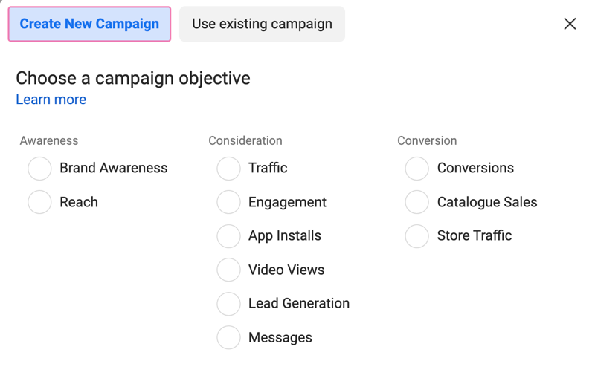
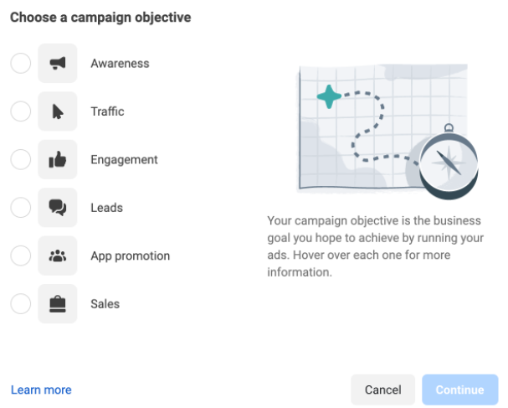
Chapter 01
Chapter 01
Agenda
Campaign Objectives
ODAX is Facebook’s new campaign objective flow. Going forward, Facebook advertisers will have 6 objectives to choose from, instead of 11.
05

Slide 11
Chapter 01
Tips per Campaign
Reach Campaign
The only campaign you can set a frequency cap (Ad set level → Optimization and delivery → Show more options → Frequency cup)-see more in Chapter 5
Recommended for local advertising (because of the frequency cup)
Algorithm is finding the cheapest clicks, manual placements recommended to get rid of low-quality clicks
Traffic Campaign
Always good to use it to bring traffic on the website, show new products etc.
You can test creatives (since it is cheaper than conversion for example) by monitoring CTR rates
Video Views
Very good for branding
More attractive as creative
Very useful for retargeting (Create custom audience → Source: video → Anyone who watched at least 50% of your video → create audience). If you do not have many video views, you can select anyone who watched at least 3 seconds of your video. However, anyone who watched more than 50% of your video is a quality audience of yours
You can retarget anyone who watched 100% of your video and offer a special offer to them specifically
Recommended video length: 3 to 15 seconds
Lead Generation
You must have Privacy Policy to create it
Only ask for the basic details (name, surname, email, phone number)
Data are stored for 90 days
06

Slide 12
Chapter 01
Tips per Campaign
Conversion Campaign
You can use multiple formats (single images, videos, carousel, collection, catalog)
Catalog Sales
If you choose dynamic formats and creatives, each person from your target audience will see first the products he/she is most likely to interact with
If you use catalog for remarketing, each person from your target audience will see the products he/she viewed or added to card. This is the recommended way if you have a catalog, as it is researched to be more effective
Messages Campaign
Helps you create relationships with your customers
Answer to questions and provide support
“Creativity without strategy is called art, creative with strategy is called advertising”
– Prof. Jef L. Richards
07

Slide 13

Chapter 02
Budget and scheduling
How much should your budget be?
Which type of campaign should have the most budget?
Is it better to use the Campaign Budget Optimization?
Can I put the same budget across all the markets I am targeting?
Let’s answer to these questions!
What should your budget be depends on the objective you have. If your objective is to drive more sales, then your budget should be higher. If your objective is to improve your brand awareness, then you do not need as high of a budget.
Depending your target market, your budget should be higher or lower. For instance, if you target the USA that is a country with billions people, where the competition and cost per click is higher, then you should have at least 100 euros daily in conversion or catalog sales campaigns.
Pro tip: if you target a big country and your budget is limited, then try to smaller your audience, either by selecting only some towns/regions, or by using cost cups.
Conversion or catalog sales campaigns with optimization for add to card or purchase are the highest priority and need the most of your budget, as the algorithm is trying to find people who will most likely take these actions (which is more expensive than finding people who view products or send messages for example).
08

Slide 14
Chapter 02
Budget and scheduling
Campaign Budget Optimization (CBO): this option is at campaign level and means that the algorithm is going to decide to which ad set the most budget will be spent on, depending on performance (conversion rates, engagement rates).
This is a very good option when you want to test audiences. You set your 4-5 different ad sets and let the algorithm do its magic. After 7-10 days, you see which ad set or ad sets have the best performance, and you keep only these ones.
Important tips:
If you see that some ad sets are not promoted at all by the algorithm (they do not even spend money) and your goal is to show these ad sets as well, then it is better to put budget in ad set level to be sure all ad sets will run.
Do not test more than 5 ad sets per campaign as it will be harder for the algorithm to be optimized.
If you only have one ad set, then there is no difference if you are going to put your budget at campaign or ad set level.
Daily or lifetime budget? Generally, daily budget is considered to run better, as you pressure the algorithm to bring you results every day and you enter the auction more dynamically. However, it is better to test both in your account in order to compare the results.
Scheduling: In ad set level, after you select you budget, you select the time frame you want your ad to be active. Generally, it is preferable not to select an end date, as you may decide to run it for longer in the future. This can affect the performance of the campaign, as by stopping a campaign and continuing it later will make it go through the learning face again.
09

Slide 15

Chapter 03
Audience Targeting
What are the types of audiences?
Which one is the best fit for your business?
Acquisition audience
This is the prospective audience, people who have not interacted before with your website/page and are new (prospective) clients.
How can you find prospective clients?
Broad audiences: by defining only the location, gender and age of the people you want to target
Detailed targeted audiences: by defining the location, gender, age and specific interests/behaviors/demographics of the people you want to target
Lookalike audiences: by defining the source from which you want Facebook to find lookalike people in order to take certain action
How to choose the right fit for you
Each business is different. This means, broad audience might work good for you, while lookalike audience might work better for someone else. Only when you try and compare the results, will you know which type of audience is best suitable for your case.
However, there are some tips that can be applied in every account.
When you are in the beginning of your Facebook ads, its better to first try broad and detailed targeting audiences in order to see what brings the best results (examples: lower cost/result, higher CTR rates, engagement rates – see more in chapter 7)
Try lookalike audiences when your account is mature enough. This means that you have achieved at least 100 events (example: at least 100 purchases if the goal is to create lookalike audience according to people who have already purchased from your website in order to find more prospecting customers).
10

Slide 16
Chapter 03
Audience Targeting
Broad audiences
Whether you set up your Facebook campaigns now, or you already run your ads for quite a while, you should always have broad audience in mind.
If your account is mature enough (meaning, there are many data in Facebook pixel – you can see that in Events Manager), when you use a broad audience, the algorithm will already know where to show your ad.
If your account is new, a good strategy is to run broad audience campaigns for quite a while until you gather enough information and data which you can use in the future.
B. Detailed targeting audiences
Detailed targeting can help you target specific people. You can target by using:
Demographics
Interests
Behaviors
For example, if you have an e-commerce selling clothes & accessories, you can choose clothes, online shopping, accessories, fashion among others for your detailed targeting.
Important tips:
Do not choose more than 10 interests in your detailed targeting options, as you make it more difficult for the algorithm to perform. Also, if you use multiple interests and your ad performs well, you will not know which interests is the one bringing you the results in order to scale it in the future.
Detailed targeting expansion: this option appears under the selection of your interests by checking a box. This will help your campaign achieve lower cost per result (most of the times) as it will show your ad to more people. If you want to find very specific customers, do not select this option.
11

Slide 17
Chapter 03
Audience Targeting
Narrow audience: by selecting certain detailed targeting options and then by narrowing down these options by one or more interests, you make your potential reach smaller. If you try this option and your costs per result are high, then remove this option, as you limit your audience. Example: detailed targeting using the interests' books, reading, online shopping and narrowing down to the interest engaged shoppers. This will show the ad to people interested in books, reading or online shopping, and have also clicked on shop now in ads on Facebook.
B2B targeting: Facebook is not famous for its B2B targeting, as it has data for personal profiles. However, there are some targeting options you can use when you want to target businesses. These are: Facebook page admins and business owners. You can find categories within Facebook page admins (example: Facebook page admins for food and restaurant or Facebook page admins for hotels).
C. Lookalike audiences
Lookalike audiences can help you find prospecting customers, as algorithm will use the data of your website visitors / social media engagers / customer lists or other sources in order to find similar people to those who have already interacted with you.
Important tips:
Be careful to have a large enough source in order to create your lookalike audience. The bigger the source, the better (minimum: 100 events)
If you want to achieve more sales, use purchases or add to cards as your source audience. Anything else will hardly work for you, as many people visit tons of websites every day, or engage with many pages, but only few of them take an action. Therefore, people who have purchased or added to card from your website are more qualitative audiences to use as a source audience for your lookalike (if your goal is to achieve more purchases).
The more the data, the better. Campaign is going to perform better if algorithm has enough data to process so it can be optimized better. Therefore, it is better to choose 180 days in retention.
12

Slide 18
Chapter 03
Audience Targeting
How relevant do you want your lookalike audience to be? The closer you are to 1%, the more relevant (and more qualitative) your audience will be. However, be careful not to create a very narrow audience. On the other hand, be careful not to create a very broad audience too (more than 5% might be too broad).
Pro tip: You can start by creating 4 to 5 ad sets with Campaign Budget Optimization on in order to test which lookalike audience brings the best results:
Ad set 1: lookalike 1% from previous purchases (retention 180 days)
Ad set 2: lookalike 2% from previous purchases (retention 180 days)
Ad set 3: lookalike 3% from previous purchases (retention 180 days)
Ad set 4: lookalike 4% from previous purchases (retention 180 days)
Ad set 5: all the 4 above lookalike audiences together
After testing from 7-10 days, you can choose the 1 or 2 ad sets performing better and scale them.
2. Retargeting audience:
This is your warm audience, people who have already interacted with your website, Facebook or Instagram page, forms, videos or other sources.
In catalog sales campaign, you can automatically select to retarget people in the audience section, and you can choose which type of audience you want to retarget (people who viewed your products or added to card but did not purchase). Highly recommendable for e-commerce shops.
If you want to retarget people using conversions, traffic, reach or other campaign, you must create a custom audience (from audience section you click on create new → custom audience → then select your source and retention).
Important tips:
If you do not have many data, or it is your first-time trying remarketing audience, choose higher retention (last 30 days, last 60, 90 or 180 days) and choose multiple audiences (website visitors, engagers, video viewers).
If you had run a video views campaign in the past, retarget people who
viewed more of 50% of your video, as this is a qualitative audience
(check if the size is big enough first).
13

Slide 19
Chapter 03
Audience Targeting
Pro tip: Use Campaign Budget Optimization (CBO) to test 4-5 different remarketing ad sets to see what best works for you.
Ad set 1: Remarketing from people who viewed or added to card but did not purchase the last 14 days
Ad set 2: Remarketing from people who viewed or added to card but did not purchase the last 28 days
Ad set 3: Remarketing from people who viewed or added to card but did not purchase the last 60 days
Ad set 4: Remarketing from people who viewed or added to card but did not purchase the last 90 days
Ad set 5: Remarketing from people who viewed or added to card but did not purchase the last 180 days
After testing from 7-10 days, you can choose the 1 or 2 ad sets performing better and scale them.
Remarketing by time spent: when creating a custom audience, you can select the option to retarget people based on the time spent on the website. If you choose the option 25%, this means algorithm will try to find the 25 people out of 100 that spent the most time on the website. This audience is also worth testing.
Cross-sales: in catalog sales campaign, you have the option to do cross sales. This means that you will show a certain product set to people who have already purchased from another product set of yours. Example: you have the new summer collection coming and you want to show it to the people who bought from your winter collection.
To check the size of your retargeting audience: All Tools → Audiences
In retargeting campaigns, you always optimize for purchases (and not clicks, view content or add to card) as you retarget people who have already viewed or added to card and you want to convince them take the next action, which is to purchase.
A good size to consider start remarketing campaigns: at least 7K visitors and 200 add to cards.
14

Slide 20
Chapter 03
Audience Targeting
In the ad set level, under the “Audience” section, you will have to select the following:
Location
Age
Gender
Detailed targeting
Important tips:
If you advertise only local and select your specific area in the location section, it is probably better not to select detailed targeting as well, as you might narrow your audience a lot, since you already make it narrow just by the location.
You can not advertise to people less than 18 years old. If our target audience is younger, you must think of other ways to reach these people (for example by targeting their parents).
By selecting Columns → Breakdown → By delivery → Age/Gender, you can see the reach in every age group or gender your campaign performed.
“Don’t find customers for your product. Find products for your customers”
– Seth Godin
15

Slide 21

Chapter 04
Placements
What are placements?
Manual or automatic placements?
How many placements should you choose?
In ad set level, one of the sections you will notice are Placements. Placements are where your will appear. Will that be Facebook feed? Instagram stories? Messenger? Facebook marketplace?
There are 2 options within the placements:
Automatic placements, and,
Manual placements
Automatic placements: this means your ad will appear in all the available placements (Feeds, Stories, In-Stream, Search, Messages, In-Article, Apps). Generally, Facebook suggests this options, as the algorithm will be more flexible and will have more opportunities to show your ad.
Manual placements: this means you select the specific placements you want your ad to appear. If you have a certain type of media that you think won’t look good in all placements, then you can unselect them. Also, if you have already done some tests about which placements bring the most results to your specific case, then you can only keep these options.
Important tips:
Select at least 4 placements, as it is very important to give flexibility and liquidity to the algorithm
In reach objective it is better to select the manual placements option. The algorithm is trying to find the lowest clicks possible. By eliminating the placements in reach campaigns, you can achieve to get rid of the lowest quality clicks.
Create different ad sets separately for Feed or Stories if you have the right creative for each type of placement.
16

Slide 22
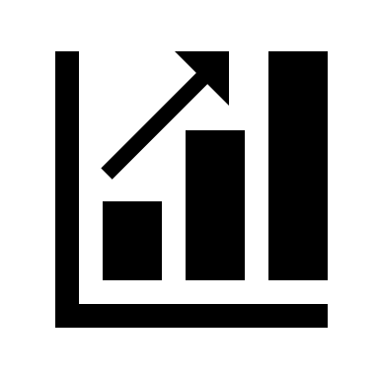
Chapter 05
Optimization and delivery
What is the best optimization according to your objective?
What is the frequency cap?
What is the bid cap?
Optimization and delivery is an important section that you will find in ad set level. There, you tell the algorithm according to what you want to be optimized for. Is it conversions? Link clicks? Landing page views? Reach?
To think about what you will choose in this option, think about your goal. If your goal is to achieve sales, then you should optimize for conversions. After you select that, one more option will appear, which is according to what event type you want your campaign to be optimized for. If again your goal is sales, you select purchases. If your goal is to gather more add to cards, you select add to card. In most of the cases, conversion and catalog sales campaigns are optimized for conversions.
If you run a Traffic campaign and your Facebook pixel is active, the best case is to optimize for landing page views. This will allow the algorithm to be optimized for people who will most likely open a website by clicking on the call-to-action button. If you do not have a Facebook pixel yet, or enough data, it is better to optimize for link clicks, so that the algorithm will bring you people who tend to click to ads.
On the other hand, if you run a Reach campaign, the best way would be to optimize for reach, as your goal is to be seen by the most people. In the reach objective (and only), you have the “show more options” button after you choose your optimization. There, you can also edit your frequency cap, which is how many impressions per week you want the algorithm to achieve. A good example would be to select 2 or 3 impressions every 7 days (more than that could be considered as aggressive).
17

Slide 23

Chapter 05
Optimization and delivery
Bid caps are set at the ad set level and instruct Facebook to not bid more than a selected amount for a certain event. The event that the bid cap applies to, will depend on the objective of your campaign. If you use the sales objective and instruct Facebook to optimize for add to carts, your bid cap will determine the maximum amount Facebook will bid for an add to cart. On the other hand, if you use the traffic objective, your bid cap will let Facebook know the maximum amount you’re willing to pay for a link click or a landing page view.
Keep in mind that a bid cap is not a guaranty that your campaign will bring only low CPRs with maximum performance. If the algorithm, especially during the learning phase can't find results on a lower cost than the bid cap, then it just not spend the budget set. Bid caps are there in order to stop you from spending money when it is no longer profitable to do so.
The best way you can use bid caps is not by setting unrealistic limits but by preventing costs from skyrocketing. For example, going into a seasonal moment like Black Friday, the average cost per result will naturally increase due to higher competition in the auction. Having a realistic bid cap option will prevent you from spending unnecessary budget.
And what is a realistic bid cap? To find out, first you need to gather enough data in your account. If you put a bid cap in a new account, it will not probably work as you expect. After gathering enough data, you can set as bid cup as the average CPR the account has achieved over this period of gathering data, plus a 30% more. This is a good start, and then you adjust accordingly.
18

Slide 24
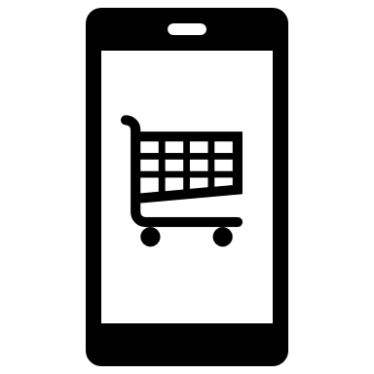
Chapter 06
Creatives
How should your ad look like?
What should your call-to-action button be?
How important is the ad copy?
What is the best ad format for you?
What is the relevance score?
The final step to complete your campaign, is your ad itself!
As you can imagine, the ad is important, as it transmits your message and the action you want your audience to make.
There are 3 ad formats:
Single image or video
Carousel
Collection
Which one should you choose? This depends!
Usually, e-commerce shops use mainly carousel or collection ads to show their products, whereas service-based companies use single images to communicate their message.
However, this is not the case for everyone. A service-based company might use carousel to demonstrate the variety of services it provides, or an e-commerce shop might use a single image to promote that a new collection is here.
The best way to decide what ad copy works best for you, is to try first. Spend several months trying different ad formats and ad copies to see what brings you the best results, and then keep up with it!
What about your call to action button?
Your call to action button demonstrates the type of action you want your audience to take after seeing your ad. If your goal is to achieve more purchases, then a “Shop now” button is more relevant. If your goal is to drive traffic into your website so that people can learn more about your business, then a “Learn more”
button is more suitable.
19

Slide 25
Chapter 06
Creatives
What should your ad copy talk about?
Your ad should ideally talk about what the product is offering to you, and not about the product itself.
When writing your ad copy, it is good to have your ideal customer persona in your mind.
You should include only one call to action in your ad
If there is a specific price/discount information, make sure it is visible!
Important tips:
When choosing a manual carousel, you can only choose up to 10 photos
When you choose your catalog as creative, there is no limitation to the number of pictures. If someone keeps swiping right to see more products, he/she will see all the products your product set includes.
In remarketing campaigns using the catalog, everyone seeing the ad will see the specific products they viewed/added to card.
In dynamic formats and creatives everyone seeing the ad will see the products he/she will interact best first and in the format he/she will interact best (either carousel or collection).
If you turn off the dynamic formats and creatives and choose your product set, you can also select the option of Slideshow and in every carousel photo you will see more photos of the same product.
It is good to have 3-4 ads per ad set to give the opportunity to the algorithm to be more flexible and diverse.
What is your relevance score?
“Facebook's relevance score is a rating on a scale of 1-10 that demonstrates how well your Facebook ad is being received by your target audience. Once an ad has received 500 impressions, Facebook will generate a relevance score for it, with 10 being the highest.” (Robinson, 2019)
To improve your relevance score:
Improve your quality ranking (this is about your landing page, if you are doing click baits or have misleading content)
Improve your engagement rate ranking (if your audience is interacting
with your ad)
Improve your conversions rate ranking (f you achieve the conversions
goal you have set)
20

Slide 26
Chapter 06
Creatives
Types of ads:
Value ads (show something customers want to know)
Demonstration ads (show how you make your products, how you deliver them etc.)
Testimonial ads (show the results of the previous customers)
Call to action ads (invite your audience to take a certain action)
“Make it simple. Make it memorable. Make it inviting to look at”
– Leo Burnett
21

Slide 27

Chapter 07
Performance Metrics
What are they key performance metrics you should pay attention to?
Below there is a list of the key performance metrics anyone should look for after running a Facebook campaign in Ads Manager.
Results: how many results your campaign achieved. If you optimized for purchases, this is the number of purchases your ad achieved in a given period. If you optimized for landing page views, the results are the number of landing page views your ad brought.
Cost per result: the cost per result according to the optimization you have selected.
Frequency: how many times on average a person has seen your ad. It is better to look at frequency at a 7 days level.
CTR (click through rate): the percentage of the people who navigated in your website after clicking on your ad.
CTR (all): the percentage of the people who clicked in your ad
ROAS: the return on ad spend. For example, if your ROAS is 4, this means that for each euro you sent on Facebook, 4 were returned to you.
Average video watch time: how many seconds on average each person saw your ad.
Important tips:
For the Greek market, if your CTR is 1,5% or higher, this is good. Otherwise, it means that either your ad is not attractive enough, or your audience is not the right one.
In general, a ROAS > 3 is considered to be a good one. However, each business has its own costs and goals, so this might vary according to each sector.
For acquisition campaign, your frequency should be around 1 and 2. For remarketing campaigns, it depends. If your performance is good, you do not pay much attention to your frequency. But in general, it is not good to be more than 12, as people may report your ad as spam (and then the algorithm is going to “punish” you with higher costs per result).
Ideally, your cost per landing page view should be lower than 0,10 euros (for the Greek market).
22

Slide 28
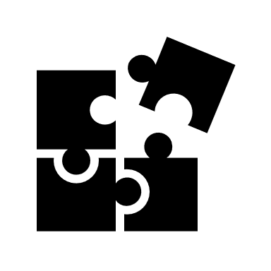
Chapter 08
Basic – key concepts
What is auction overlap?
What is audience saturation?
What is the learning face?
What are the attribution settings?
How are you being charged on Facebook ads?
What are some critical seasonal moments influencing every type of business?
How do you spy on your competitors?
What is auction overlap?
“Auction overlap refers to what happens when you have multiple ads that attempt to enter into the same auction. This occurs when more than 1 ad sets have the same or similar audience.” (Loomer, 2017)
In ad set level, you can select the “Inspect” button from your left side menu. If you do not use a dynamic format in your ad, you will be able to see your auction overlap.
Up until a percentage of 15-20%, auction overlap is sometimes unavoidable. But more than this percentage means that you should probably make a change in your audiences.
What is audience saturation?
“Audience saturation measures how often people are seeing your ad for the first time, among other things. A more extensive way to recognize audience saturation is by using Facebook's delivery insights.” (Loomer, 2017)
First time impression ratio: if it is more than 50% it is good because it means than most of the impressions are fresh. The ad set does not need any treatment for audience fatigue.
Audience reached: for example, 1,8% means we are not close to fatigue. If it is too late and it is already fatigued, then changing creative is not going to save the day, you must expand your audience to new eyes.
23

Slide 29
Chapter 08
Basic – key concepts
What is the learning face?
“The learning phase is the period Facebook takes, after an ad campaign has been launched, to figure out how it can generate the best possible results for your campaign. Facebook does this by showing your ad to different people within your target audience and then calculating who is most likely to act after seeing your ads.” (Nasser, 2019)
The learning face will last until you gather approximately 50 events (if you optimize for link clicks, 50 link clicks, if you optimize for add to cards, then 50 add to cards) in a 7 days period.
Do not make significant changes within your ad set when it is going through the learning face, as this can cause it to reset. Facebook needs a bit of time to generate the relevant data in order to give your campaign a boost!
If after the seven-day learning phase period your ad set doesn’t achieve 50 optimization events, it enters “Learning Limited” status. However, this is not so scary!
There are multiple reasons why an ad set gets in this status: small audience size, low budget, low bid or cost control, or running too many ads at the same time. This does not mean that your ad set has stopped running, but it is a warning that you may consider and do some changes.
What are some critical seasonal moments influencing every type of business?
Seasonal moments, are the celebrations that businesses take advantage of to sell more. Examples: Valentine's Day, Halloween, Black Friday, Cyber Monday, Christmas, Easter are some of them.
What happens during this period? Even if you are not a business that is not influenced by seasonal moments, do you also get affected? The answer is yes!
Many advertisers increase their budget during this period, which means the competition is higher. So, whether you are a business that takes advantage of seasonal moments or not, you are getting affected as you may notice higher
costs during these periods.
24

Slide 30

Chapter 08
Basic – key concepts
Important tips:
Prepare yourself for a seasonal moment at least 2 weeks earlier so that you warm your audience, and the algorithm has more data about to whom to show your ad to.
Create deadline driven deals!
Capitalize on creative
Retarget last year’s audience
Increase your budget at least 20%
How can you spy on your competitors?
The first tool to spy on your competitors is called “Ads Library”. There, you can either select a keyword (for example: fashion) and all the related ads to this specific keyword will appear. Or, you can type the names of your competitors and their active campaigns will appear as well.
If you see an ad of your competitor which is active for very long, it means this works for them and keep it active. You can then have an idea about the formats and copies your competitors use. Are they using catalog, single images or videos? What are they writing as a primary text?
The second thing you can do to spy on your competitors, is to find what their target audience is. How to do that?
If their ad appears on your feed, select the option “Why am I seeing this ad” and information about their target audience will appear to you. For example, if you get the message “This ad is shown to you because you have similarities to their audience”, means this ad targets lookalike audiences. You will not get 100% information about the target audience (for example what is the source of the lookalike audience or what percentage of similarity they are using), but you will have a general idea.
25

Slide 31
Chapter 08
Basic – key concepts
What is the Attribution model?
When we talk about attribution, we are talking about when and how a conversion is getting attributed to a Meta placement. Whenever you get a conversion, either is a lead, a purchase or any other type, Meta will attribute that conversion to an ad so that you can see in Ads Manager which campaign brings the results that you want.
Changing the attribution window on a campaign can result immensely on the quality and quantity of your data.
Currently there are 4 main types of attributions. These 4 types base themselves in 2 actions. The first one is click which means that when someone clicks on your ad (specifically the call-to-action button) and then makes a purchuse, that sale is getting attributed to Facebook. The second one is view, which works in the same logic. If someone gives an impression to your ad and then complete a purchase, this purchase is getting attributed to Facebook.
Attribution settings:
1-Day click: In this case the attribution window is a day. That means that Meta will give credit to your Facebook campaign only if someone has seen the ad up to 24 hours before. As you can understand, this option is very specific but also quite limiting.
7-Day click: This option increases the attribution window by 7 days. This gives more room for the algorithm to identify a sale and give credit to that specific campaign.
1-Day click or view: In this case the algorithm will give attribution if someone sees or clicks on the campaign again up to a day before. As explained on the fist point 1-Day attributions are very specific but very limiting as well. There’s a lot of cases where a potential customer will see an ad or even click on it and then do the purchase some days later as he might remember the brand. This sale will not get attributed to Facebook.
26

Slide 32
Chapter 08
Basic – key concepts
7-Day click, One day view: This attribution setting is the one that gives the most opportunities for the algorithm to give credit to a campaign. Also, it is the by default setting right now and the one most advertisers are using.
Which is the best one?
That depends on what you want and what's the end goal of your campaign. In simple words, if your goal is to understand and track a customer's final actions like a last-minute purchase or an impulsive one, then shorter attribution settings are the best. If the end goal is to track every action of a customer's journey or action path, then the longer attribution windows are better suited. What matters is that all attribution setting have their strengths and weaknesses and you must find which one is more fitting for your campaign.
How are you being charged on Facebook ads?
There are two ways in which Facebook is charging you and that’s (1) Impressions and (2) CPC (Cost per click).
You can choose one or the other, but honestly after a lot of testing, the truth is that there is no great difference between the two in terms of performance. Facebook is just presenting the data from a different standpoint and your receipts in a different form. Now that you know how you are getting charged, you can draw conclusions and get information for other metrics. For example, when a campaign needs a lot of impressions in order to achieve a conversion or any other objective goal for that matter, then the metric of CPM (Cost per thousand impressions) rises. When CPM gets higher, consequently CPR (Cost per result) is increasing as well. That means you will have a higher total cost for your campaign. The 2 main reasons why your campaign needs more impressions in order to reach a conversion are: Audience targeting and how your Creative is getting perceived. In simple terms, if you have reached your true target audience, then people are going to click on your call-to-action button much easier. Also, if your creative is engaging, interesting and relevant, then users are going to take an action much faster. So, as you can see, everything is connected. Even the CTR (Click through rate) metric has a positive correlation with CPM and total cost.
27

Slide 33

Chapter 09
Events Manager
Facebook Events Manager is a tool for tracking actions on third-party websites and apps.
To find this tool, connect to your Ads Manager account. From the left side menu, after clicking on “All tools”, select “Events Manager” and you will be redirected to it.
What is a Facebook pixel?
“The Facebook pixel is a piece of code that you place on your website. It collects data that helps you track conversions from Facebook ads, optimize ads, build targeted audiences for future ads and remarket people who have already acted on your website. It is a browser-dependent conversion tracking method.” (Newberry, 2022)
Facebook pixel is free. Advertising of course is not, but the Facebook tracking pixel is. You can have maximum 100 Facebook pixels in your Business Manager account.
Facebook pixel is very useful to have, as it make you capable of understanding at which level the business is, how mature the account is, and what steps need to be done for campaigns to be optimized better. For instance, if you see that the “view content” event has tracked a very small amount of people, it means you first must focus on creating ads with “view content” optimization and not “purchase” right away.
By opening the Events Manager, you are automatically redirected to the “Overview” section. After installing your Facebook pixel to your website, you can see your events. The most important events you should track include:
Page view
View content
Add to card
Initiate checkout
Purchase
Contact
Lead
Search
28

Slide 34
Chapter 09
Events Manager
What is the difference between page view and view content?
Page view tracks all the website visitors, whereas view content tracks only the people who have viewed a product.
Of course, if you are in the service sector, you do not need to have all the above events.
Important tips:
If you notice a very big difference between your events (for example: you have 500 add to cards and only 10 purchases), you should check for any technical issue in your website. Is your website user friendly? Does it require many steps for someone to buy a product?
If you have a campaign optimized for purchase which is not performing well and you notice that you do not have many purchases tracked in your Events Manager (meaning your account is immature and does not have many data), a good strategy is to do a step back. Which is, in that case, optimize for add to cards. If you do not have many add to cards, you should optimize for view content first.
Pixel Setup Manual method (with coding/the hard one)
1. Have a business manager or set up one.
2. Go to business settings on the down left side.
3. Chose Data sources → Pixels.
4. Click on add → put a name on your Pixel → Continue.
5. Add people and assets (select your self and give full control, also attach the pixel to your account or any accounts that you want.
Good job you now have a pixel!
Keep in mind you don’t want to connect a bunch of pixels because it’s a nightmare to delete them.
29

Slide 35
Chapter 09
Events Manager
Now for the hard part:
1. Go to events manager on all tools.
2. Select your correct account and find your pixel, then click on continue pixel setup.
3. Select the manual install option (if you can use the partner integration method is much easier).
4. First thing you should do is Copy the base code to your site. Keep in mind that Pixel works with JavaScript, so you have to find the manage script section of the backend of your site and paste the code provided. Also, the placement should be always Head. Finally give a name to your script (ex. Facebook pixel). This must be done in every page of your site or if your site has an option to intergrade the code in every page automatically do that.
5. Press Done → Save → Republish on the top right corner. The main thing is to find the JavaScript option on your page.
What you did now is that you added the base code to your website so that Facebook can track you. However, we haven’t specified the events that we want to track. So, this is the second part:
1. Press Continue on the events manager onboarding page and go to automatic advance matching in which Facebook matches their data with your website’s data for better targeting and remarketing options.
2. Next you must add the event code. With that you indicate what you are going to track as a conversion. Now Facebook gives as an option to automatically set up events but that doesn’t always work. So, what you can do is click on "Install events using code“, then go here: Conversion Tracking - Meta Pixel (facebook.com), where you will find the following code that I give you for speed purposes fbq('track', 'Purchase', {currency: "USD", value: 30.00}), which you will add to the manage script section of your site right bellow pageview event (should be the 12th line of code). After that, you can go here: Find the "name" of the event that you want a certain action to symbolize Specifications for Facebook pixel standard events | Meta Business Help Centre. That way you can track any event you want. Click on Done →Save → Republish again.
3. Now the last thing that we need to do is test any event through ‘’test events’’ on events manager and we are all set.
30

Slide 36
Chapter 09
Events Manager
Pixel Setup Automatic method (without coding/the easy one)
The first steps on creating a pixel are the same both for the manual and the automatic method.
1. Have a business manager or set up one.
2. Go to business settings on the down left side.
3. Chose Data Sources → Pixels.
4. Click on Add → put a name on your Pixel → Continue
5. Add people and assets (select your self and give full control, also attach the pixel to your account or any accounts that you want.
Your pixel is now created. All you must do now is connect it to your site and set up the events that you want following the next steps.
1. Go to Events Manager on All Tools.
2. Select your correct account and find your pixel, then click on Continue pixel setup.
3. Select the partner integration install option.
4. Currently Facebook gives you 24 partners to choose from and of course the partner integration options are going to increase over time.
5. After you have chosen your platform (for this example we are going to use Shopify) go to your account click on Preferences and if you scroll down a little bit, you will find Facebook pixel. Keep in mind that not every partner platform works the same, but the integration is quite similar. Click on set up Facebook → Add Sales Chanel → Connect account.
6. Every platform is going to ask you for some information in order to connect pixel. Usually, this information is your account name, business manager and Facebook business page and then to accept some terms and conditions. Also, most of the platforms have various data sharing options which you must chose. Always chose the one with the most data sharing. More data means better targeting for your campaigns.
7. Finally now that you have connected your pixel, you must test if the events are working properly. Go to Events Manager → chose your account and pixel and click on Test Events. Fill your website URL in the test browser events bar and click on open website. If you have an ad blocker on, make sure to turn it off as it will block any event tracking. Now go to a specific product add to cart or even make a
fake purchase, your pixel should now track any events happening on your
website.
31

Slide 37
Chapter 09
Events Manager
What is Conversion API?
Data protection and privacy regulations have made advertisers rethink the future when it comes to digital marketing.
Conversion API, also known as the server-side API, lets you share events occurring both online and offline from your server to Facebook's server. This helps measure ad performance across multiple channels. The Conversion API does not show a user's whole journey like the pixel, but it shows the end result. The new API also allows for advertisers to send online and offline signals back to Facebook, allowing for a more holistic measurement of advertising campaigns.
What is Meta’s Aggregated Event Measurement?
Meta's Aggregated Event Measurement is a protocol that allows for measurement of web events from people using iOS 14.5 or later devices. Aggregated Event Measurement limits domains to 8 conversion events that can be configured and prioritized for campaign optimization.
Facebook will then use this ranking to decide how to track conversions from users who opt-out of tracking. If a user who has opted out of Facebook’s tracking makes multiple conversions after clicking on an ad (such as buying something and then signing up for a newsletter), only the highest-ranked conversion will be reported by Facebook.
32

Slide 38
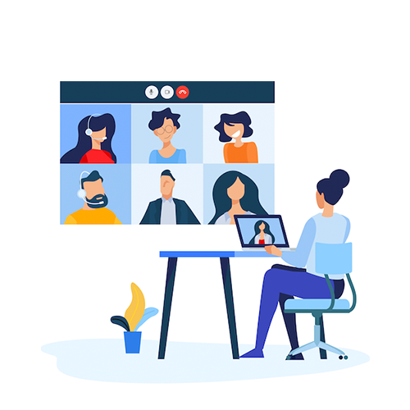
Chapter 09
Business Manager
Business Manager is a tool that gives multiple individuals or other businesses access to business data such as Pages, Ads, Custom Audience, Pixels and Verified Domains.
It is important to configure the Business Manager in the best possible way so that you can manage a lot of data on Facebook and Instagram, control access to your data, request access to your partner data and more.
The activities you can do in Business Manager include:
Link your Facebook, Instagram page(s)
Link your ad account
Add users to the Business Manager account
Boost your account security
Connect your Facebook pixel(s)
Share access with multiple people and control how much access each employee has based on their role
Access the catalog and create product sets
Manage billing details and see spend thresholds
Manage brand safety by verifying domains and creating block lists
33

Slide 39
Chapter 09
Commerce Manager
Commerce Manager is a set of tools that helps you sell your products and manage your business on Facebook and Instagram. It allows you to use the shopping integration feature, ie Facebook's online shopping solution, and manage inventory, orders, payments, etc.
The steps needed are:
Head to Commerce Manager and create your first catalog
Add items to your catalog (4 options: manually, through data feed, through partner platform or through pixel). If you have a few items, adding them manually may work for you. If you have more, then choose one of the other three ways
By creating a catalog and selling from Facebook or Instagram, you have many benefits, such as: managing your inventory, tax settings and access financial reports whenever necessary or getting useful insights about your products.
After your products are added, you may have information about some of them getting rejected. By viewing more information, you can check what policy you are violating that results in the rejection of the items. If you have a strong reason to disagree, you can always appeal.
34

Slide 40

Chapter 10
Test & Answers
1. A client approached you and tells you his goal is to boost his physical store. What campaign objective do you propose to him?
Reach campaign
Traffic campaign
Conversion campaign
Lead generation campaign
2. Your campaign achieves 0 conversion events. What might be the problem?
You have not connected your Facebook pixel
The conversion event for which you optimize for has only a few events measured
Your ad creative is irrelevant
All the above
3. You see a Lead Generation campaign with very high cost per lead. What are some ways that you can improve performance?
Increase the number of placements so that your ad has more opportunities to be shown
Increase your budget as it is below the recommended one for your target market
Lower the number of interests as having more than 10 interests can make it more difficult for the algorithm to run
All the above
4. You want to create a lookalike audience. What is the best retention period you can choose?
30 days
60 days
90 days
180 days
35

Slide 41
Chapter 10
Test & Answers
5. You are in the beginning of your business and so far, you have created your Facebook and Instagram page and your sales are done through messages. What type of audiences can you retarget?
Website visitors
Social media engagers
Video viewers
All the above
6. You want to advertise your products in Greece and Germany, so in your ad set you have chosen both countries. Is this a good strategy or not?
Yes, it is.
No, it is not.
7. You choose to run a Traffic campaign. Your account has installed the Facebook pixel, with Page View: 6K. What is the best optimization option?
Link clicks
Reach
Landing page views
None of the above
8. A custom audience is:
A new audience (cold audience)
A retargeting audience (warm audience)
9. Many products of your catalog have been rejected. Where can you find out more information?
In Events Manager
In Business Manager
In Commerce Manager
In Business Suite
36

Slide 42
Chapter 10
Test & Answers
10. You want to add a Facebook pixel in your ad account. Where do you connect it?
In Events Manager
In Business Manager
In Commerce Manager
In Business Suite
11. Your CTR (all) rate is 0,80%. What does this probably mean?
Your ad is not attractive
Your budget is too low
Your Facebook pixel is inactive
All of the above
12. It is Black Friday week, and you notice an increase in you cost per purchase. What should you do?
Increase the number of placements
Increase your budget
Increase your audience size
You do not have to do anything
13. Your ad set is in “Learning limited” status. What does that mean?
It means it hasn’t completed 50 events in 7 days yet
It means it has stopped running
It means it can not complete the 50 events in 7 days
14. You want to create a traffic campaign in the USA and your monthly budget is 50$. What strategy would be good for this case?
Increase the number of placements
Use a cost cup
Choose multiple ad formats
None of the above
37

Slide 43
Chapter 10
Test & Answers
15. What will make your campaign more flexible?
Automatic placements
Manual placements
16. Can you have a Conversion campaign without pixel?
Yes
No
17. What metric tells you what is the return on ad spend?
CTR
CTR (all)
ROAS
Frequency
18. If your relevant score is low, what is probably the issue?
The ad account is deactivated
The ad has been probably reported
The budget is too low
None of the above
19. Where can you see the reach of your ad by gender?
Ad set level → Audience → Estimated results
Breakdown → Delivery
Breakdown → Action
You can not see this information
20. Which of the following below lets you share events occurring both online and offline from your server to Facebook's server?
Facebook pixel
Conversion API
Aggregated Events Measurement
38

Slide 44

Chapter 10
Test & Answers
Answers:
1. Answer: a. Reach is recommended for local ads, as besides the fact that you can find the maximum people possible around the physical store, you can also edit the frequency cup.
2. Answer: d. All the above can be possible reasons for a campaign with low performance.
3. Answer: d. All the above are ways to help a campaign be optimized better.
4. Answer: d. When creating a lookalike audience, the best strategy is your source audience to have the most possible amount of data so that the algorithm can be optimized better.
5. Answer: b. Since you do not have a website yet and have not run any video yet, the only sources you can use for retargeting is your social media pages.
6. Answer: b. As you can also see if you select Breakdown → By delivery → By country, the most reach will come from Greece. This is because algorithm is finding the cheapest clicks there. So, if you wat to advertise in Germany too, the best strategy is to do that in another ad set with another budget.
7. Answer: c. Since your account has enough page views in your Events Manager, you can optimize for Landing page views in order to optimize for the people who tend to visit websites, and not just the people who click on ads. Landing page views will show you the more qualitative audience.
8. Answer: b. Custom audience refers to the people who have already interacted with you (such as website visitors, video viewers, engagers etc.)
9. Answer: c. In Commerce Manager you can manage your catalogs and product sets. If your products are rejected, you will see a notification to see more details.
10. Answer: b. Business Manager → Data Sources → Pixel
39

Slide 45
Chapter 10
Test & Answers
Answers:
11. Answer: a. CTR shows you the percentage of the people who click on your ad. If less than 1,5% do not click on your ad, this means you should make a change in your creative, since people are not attracted by it.
12. Answer: b. Black Friday is a moment of the year with very high competition, which makes it harder to be high in the auction. Therefore, you should increase your budget, as most advertisers do, even if you do not take advantage of this period.
13. Answer: c.
14. Answer: b. The budget is too low for the target market. A good strategy would be to narrow down the audience by selecting a cost cup.
15. Answer: a. Automatic placements will make the campaign more flexible as it allows the algorithm to have more opportunities to show the ad.
16. Answer: b. Facebook pixel is precondition in order to run Conversion campaigns, as the algorithm needs to be optimized according to some event.
17. Answer: c. ROAS = Return On Ad Spend
18. Answer: b. An ad being reported is one of the reasons that the account quality decreases, and therefore the relevance score too.
19. Answer: b. If you select Breakdown → Delivery, then you have more options appearing, one of them being the gender.
20. Answer: b. Facebook pixel is a browser-dependent conversion tracking method, so the right answer is b.
40

Slide 46

Chapter 11
Useful links
Chapter 01:
Campaign Objectives: read more here.
Automated responses: read more here.
Chapter 02:
Budget: read more here.
Daily budget: read more here.
Lifetime budget: read more here.
Scheduling: read more here.
Chapter 03:
Broad targeting: read more here.
Detailed targeting: read more here.
Detailed targeting expansion: read more here.
Lookalike audience: read more here.
Retargeting audience: read more here.
Chapter 04:
Placements: read more here.
Automatic placements: read more here.
Chapter 05:
Optimization and delivery: read more here.
Optimization for landing page views: read more here.
Frequency cup: read more here.
Bid Cap: read more here.
41

Slide 47
Chapter 11
Useful links
Chapter 06:
Ad formats: read more here.
Best practices for ads: read more here.
Instant experiences: read more here.
Dynamic creative: read more here.
Ad guide: read more here.
Creative fatigue: read more here.
Chapter 07:
CTR: read more here.
Unique clicks: read more here.
Thru play: read more here.
Metrics for Conversions campaigns: read more here.
Chapter 08:
Overlapping audiences: read more here.
Inspect tool: read more here.
Learning face: read more here.
Learning limited: read more here.
Attribution settings: read more here.
Charging on Facebook: read more here.
Ad Library: see more here.
Chapter 09:
Facebook pixel: read more here.
Events Manager: read more here.
Conversions API: read more here.
Best practices for CAPI: read more here.
Delete duplicate events: read more here.
Aggregated Events Measurement: read more here.
Business Manager: read more here.
Commerce Manager: read more here and here.
42

Slide 48
Chapter 11
Useful links
Other useful sources:
Facebook Marketing partners: see more here.
Facebook Insights: see more here.
Facebook Wi-Fi: read more here.
Facebook Ad Policies: read more here.
43

Slide 49
Agenda
“Never stop testing, and your advertising will never stop improving”
– Steuart Henderson Britt
--------------------------------------------------------------------------------------------------------

